Slide 1
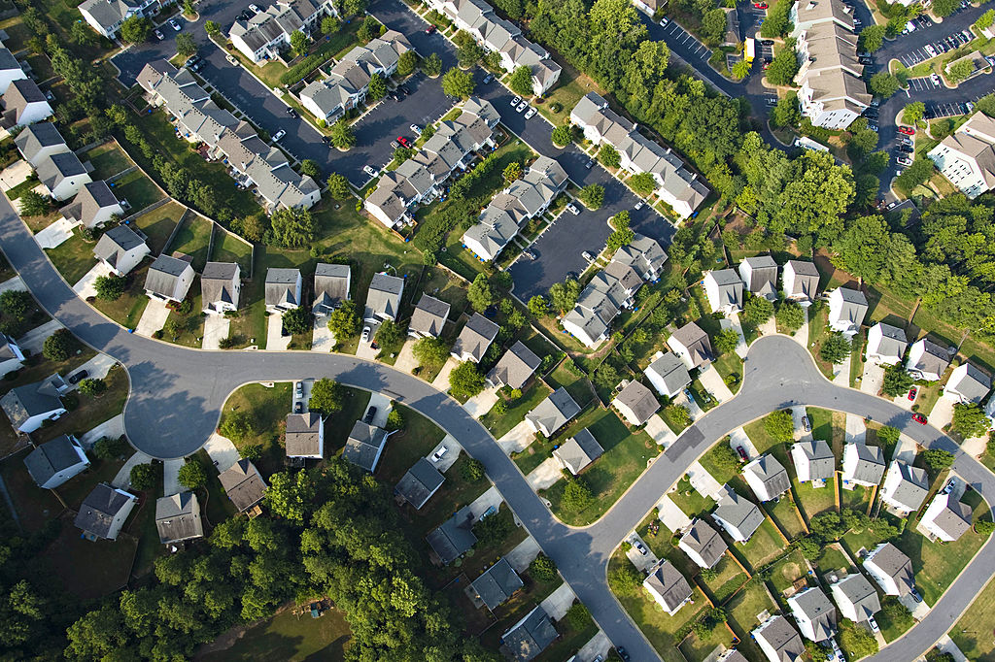

Understanding Housing Market Trends and Risks
STAT 429
Group: GR6
Kunal Bhardwaj
May 07, 2024

Slide 2


Introduction
Federal Reserve Economic Data (FRED) is a comprehensive database maintained by the Federal Reserve Bank of St. Louis.​
Aggregates data from various government agencies, international organizations, and other sources.

Slide 3
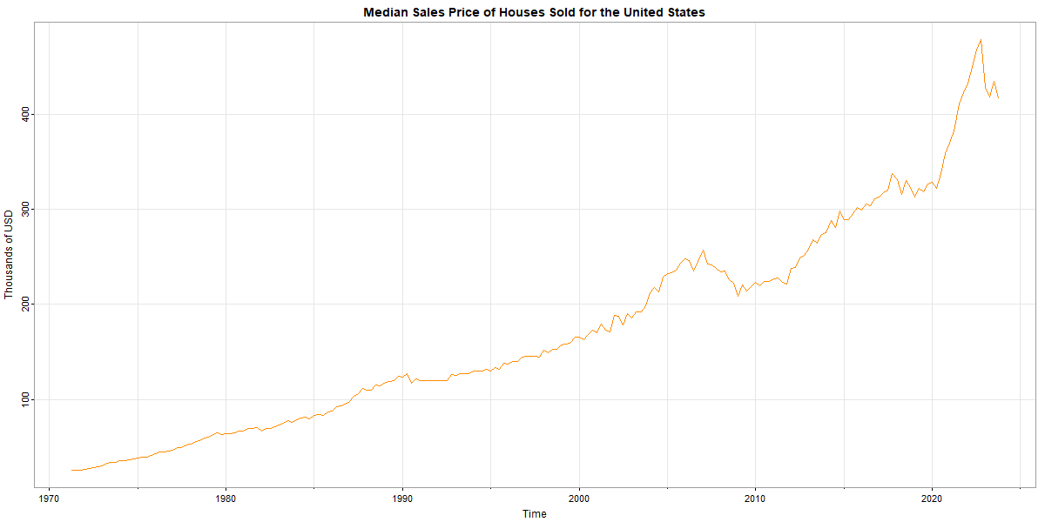
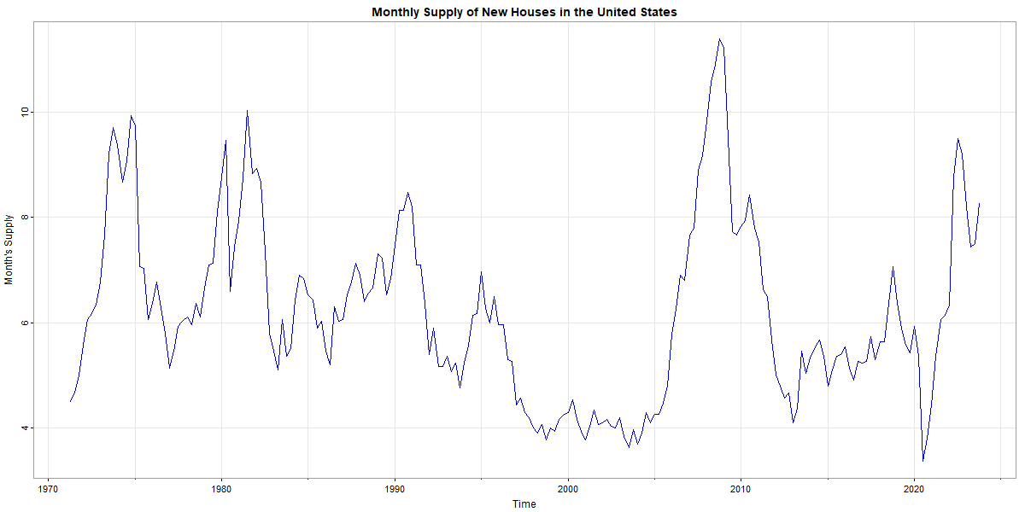
Dataset
The dataset retrieved from FRED website comprises of six time series:
i) Median Sales Price of Houses Sold for the United States
(MSPUS) [Monthly] [Jan'63 - Dec'23]
ii) Monthly supply of New Houses in the United States
(MSACSR) [Monthly] [Jan'63 - Dec'23]

Slide 4
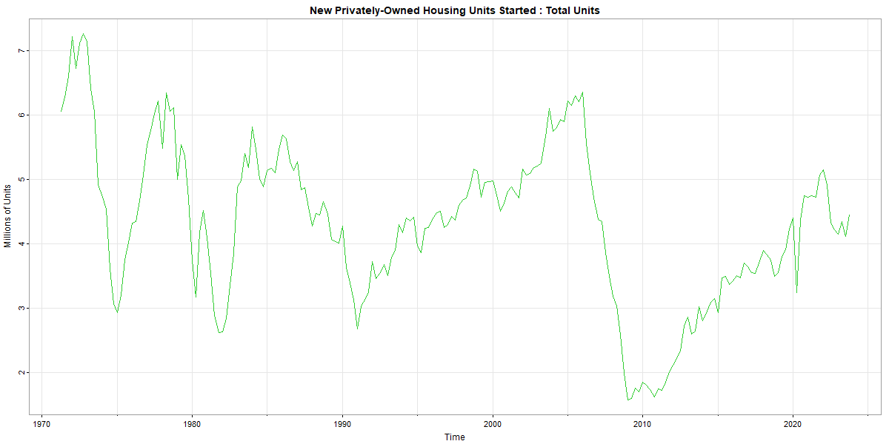
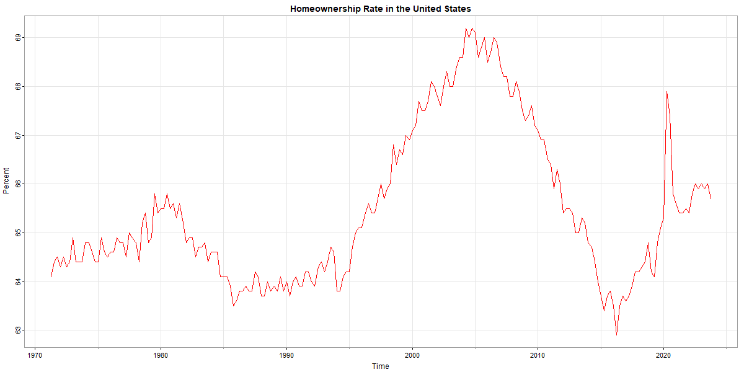
Dataset
iii) New Privately owned Housing units started
(HOUST) [Monthly] [Jan'59 - Jan'24]
iv) Home ownership rate in the United States
[Quarterly] [Q1 '65 - Q4'23]

Slide 5
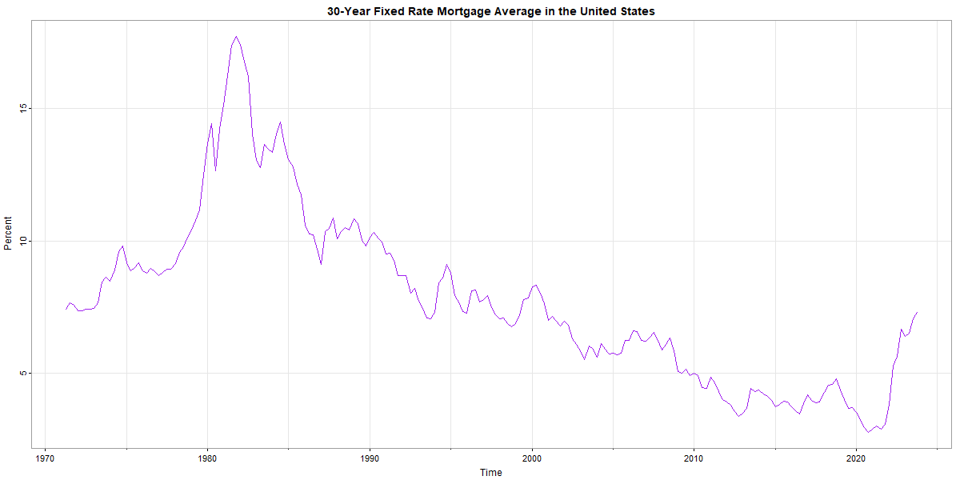
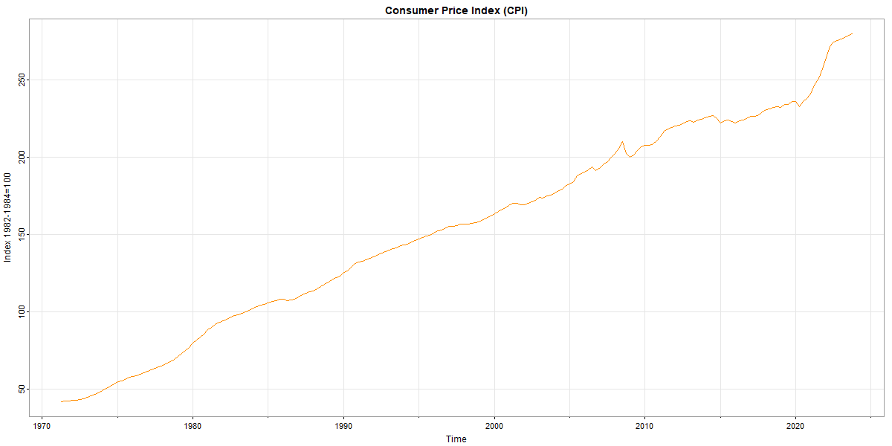
Dataset
v) 30 Year Fixed Rate Mortgage Average in the United States
(MORTGAGE30US) [Weekly] [Apr'71 - Feb'24]
vi) Consumer Price Index (CPI) for All Urban Consumers: All Items Less Shelter in U.S. City Average
(CUSR0000SA0L2) [Monthly] [Jan'47 - Jan'24]

Slide 6
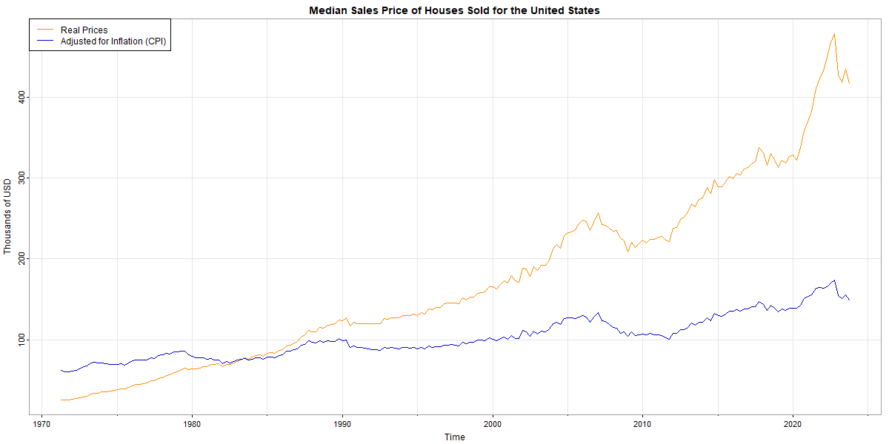
Objective
The objective of the project will be to predict Median Price (i) based on four other factors (ii), (iii), (iv) & (v).
The CPI data (vi) will NOT be used as a predictor but will be used to adjust Median Price based on inflation.

Slide 7
Objective
Find out which (if any) of the four factors have an effect on the Median Sales price of houses sold.
Identify factors that have the strongest effect on median prices.
Analysis A will be used to answer these questions.
A Regresssion Analysis will be carried out assuming uncorrelated errors.

Slide 8
Objective
Model the variance of the errors or residuals in housing prices, which can be seen as a measure of volatility.
Analysis C will consist of analyzing volatility patterns to better understand these factors.
Three ARCH models - GARCH, IGARCH & APARCH - will be used to model the return/growth rate of median prices.

Slide 9
Analysis A
STEP 1) The Median Prices (outcome variable) were pre-processed by adjusting for inflation, followed by de-trending and log transformation to make it stationary and homoscedastic.
STEP 2) The four predictor variables were converted into quarterly series if they were not already.
STEP 3) The Median Price was regressed on time and other predictors to arrive at the full model.
STEP 3.5) Multiple model sizes were analyzed to find the optimum model to be selected, based on AIC/BIC criteria.
STEP 4) Based on the p/ACF of the residuals, regression with autocorrelated errors was carried out.

Slide 10
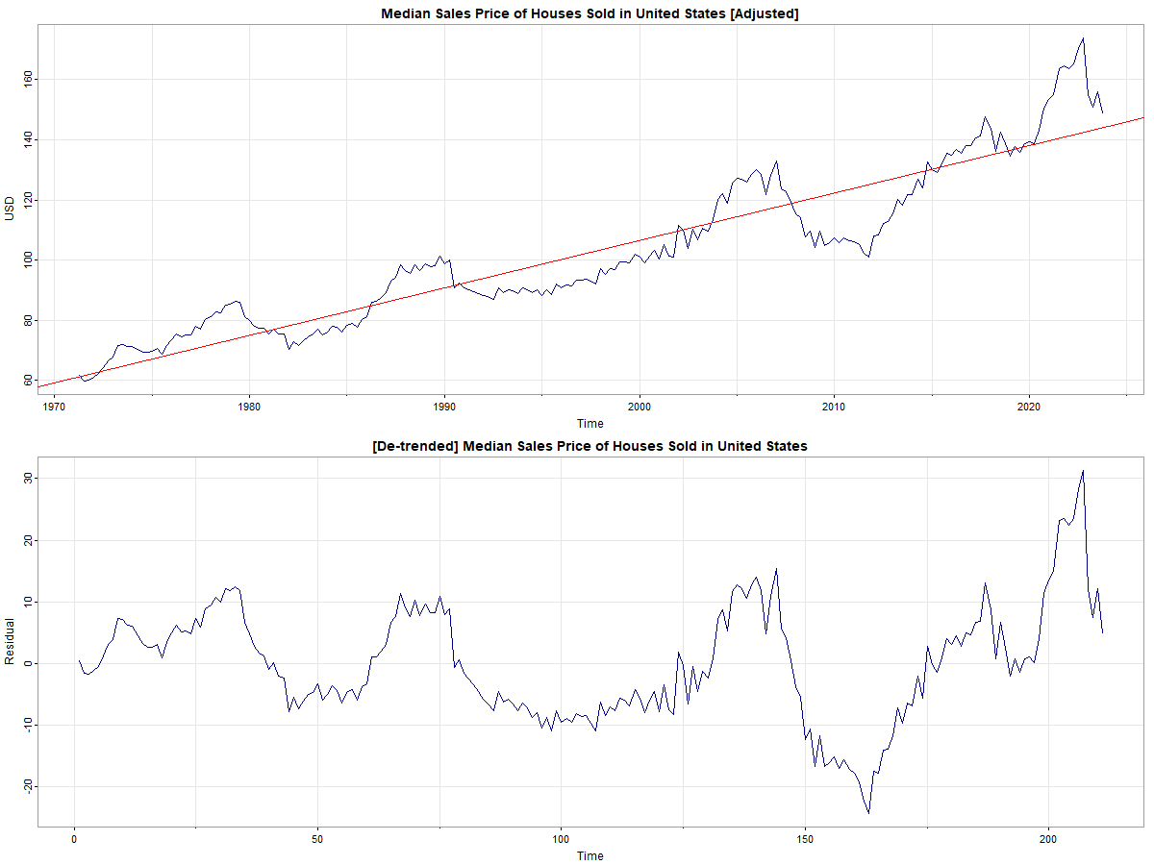
Stationarity & Homoscedasticity
Augmented Dickey-Fuller Test
p-value = 0.01
alternative hypothesis: stationary
KPSS Test for Level Stationarity
p-value = 0.1
studentized Breusch-Pagan test
p-value = 0.000000009128

Slide 11
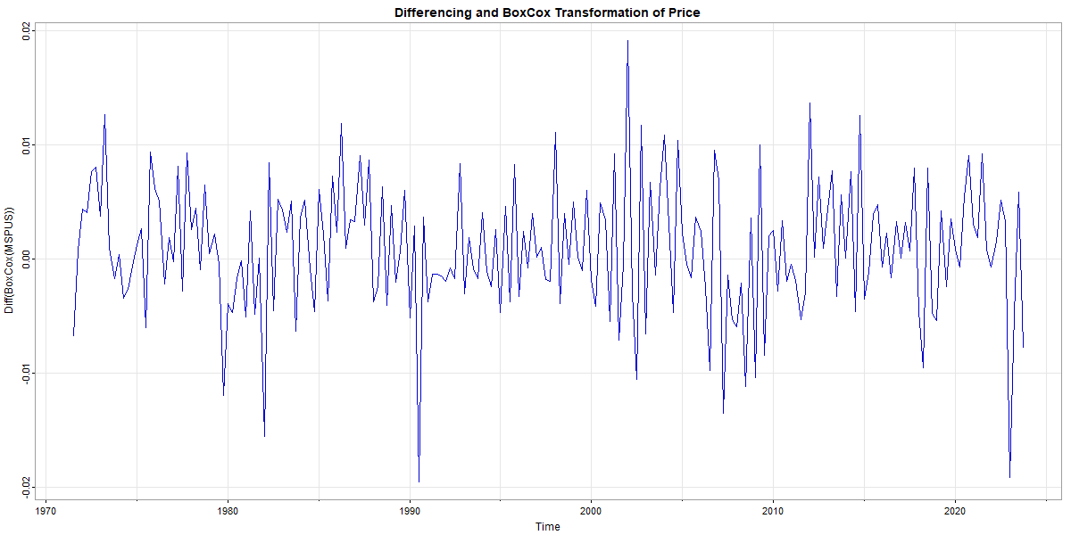
BoxCox Transformation
Augmented Dickey-Fuller Test
p-value = 0.01
alternative hypothesis: stationary
KPSS Test for Level Stationarity
p-value = 0.1
studentized Breusch-Pagan test
p-value = 0.3053

Slide 12
Regression Analysis
Fit a full model with all five predictors: time , Supply of New Houses (MSACSR), Housing Units Started (HOUST), Homeownership Rate (RHORUSQ156N), and 30-Year Fixed Rate Mortgage (MORTGAGE30US).
Use the step-wise algorithm to find the optimum model.
Run the algorithm in “both” directions to add/remove variables one-by-one to find the lowest ICs.
Use Akaike information criterion (AIC) to find the best model.

Slide 13
Model Selection by Step-wise Algorithm
Model | AIC
MSPUS ~ time(MSPUS) + HOUST+ MORTGAGE30US + MSACSR + RHORUSQ156N | Start: -2178.18
MSPUS ~ time(MSPUS) + HOUST+ MORTGAGE30US + MSACSR | Step: -2178.53
MSPUS ~ time(MSPUS) + MORTGAGE30US + MSACSR | Step: -2179.4
We conclude that MSACSR (Median Sales Price of Houses Sold) and MORTGAGE30US (30 Year Fixed Rate Mortgage Average) are significant predictors of housing prices based on AIC criteria.

Slide 14
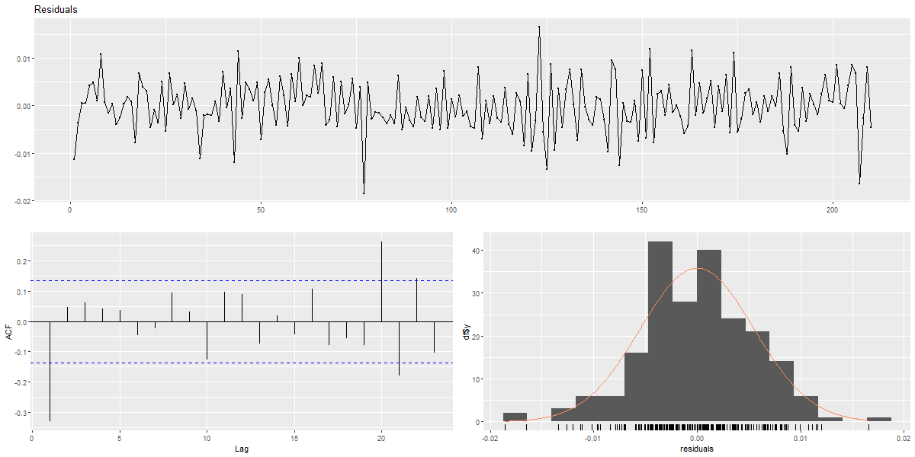
Residual Analysis
Check the assumption of uncorrelated errors:
Ljung-Box test: df = 10, p-value = 0.0004985
ACF plot shows the residuals are not independently distributed.

Slide 15
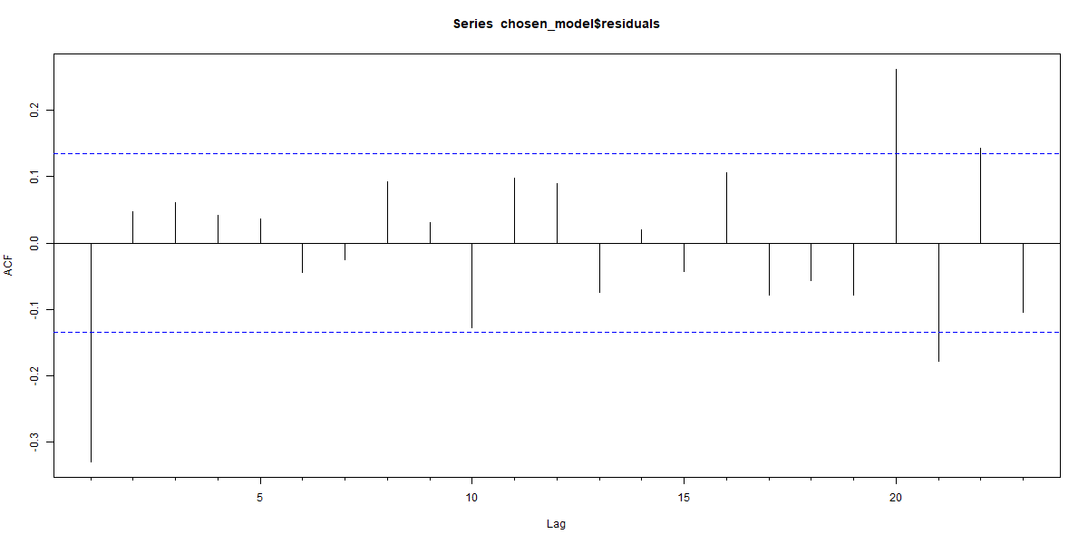
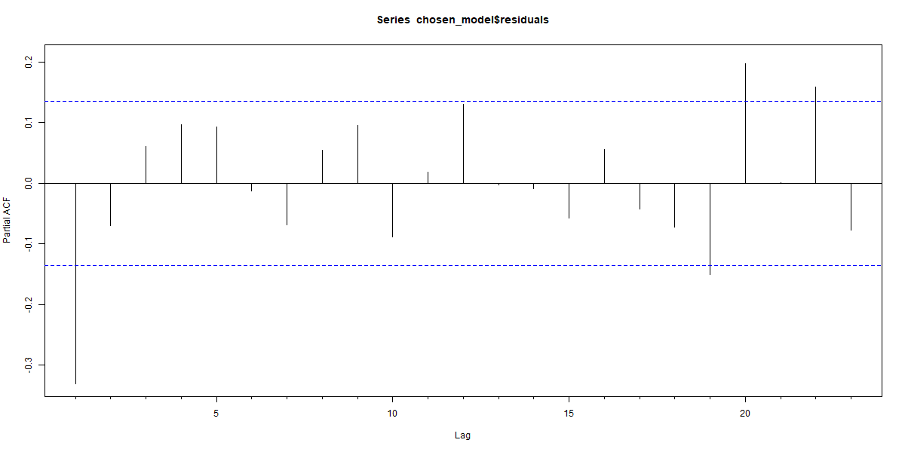
Residual Analysis
ACF cuts off after lag 1.
PACF cuts off after lag 1.
ARMA(1,1) looks like a good fit for the residuals.
Carry out Regression with autocorrelated errors.

Slide 16
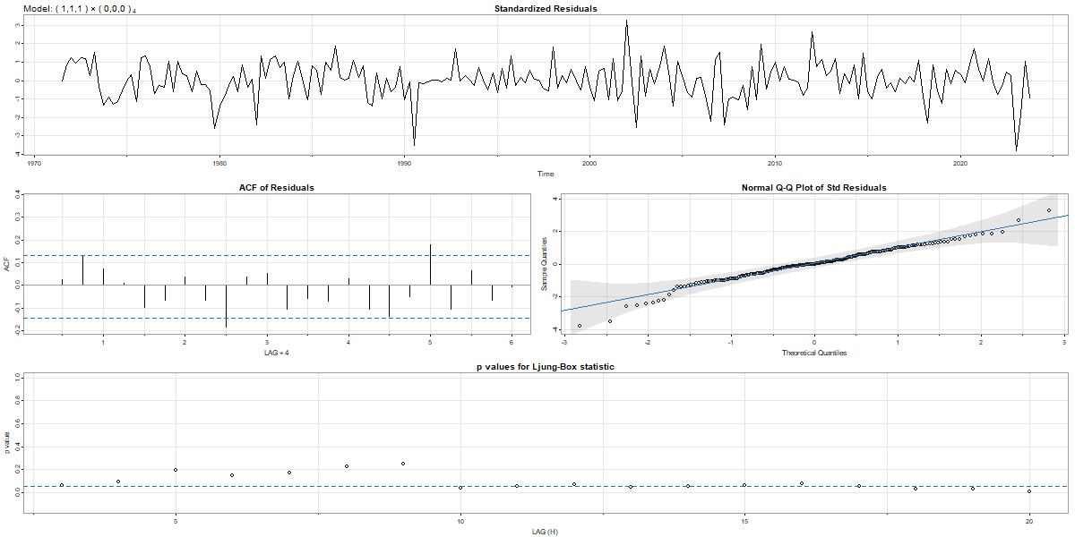
Regression with autocorrelated errors
SARIMA (1,1,1) x (0,0,0)4 shows the best performance among all models tested.
The ACF of residuals show that they now resemble white noise.

Slide 17
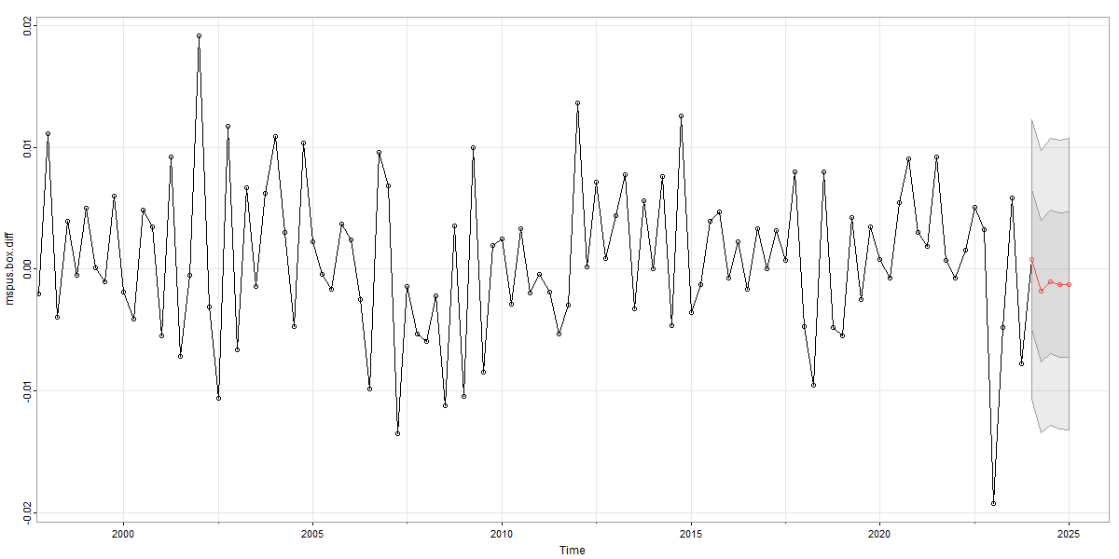
Forecasting
Carry out the forecasting of the stationary series using sarima.for() function.

Slide 18
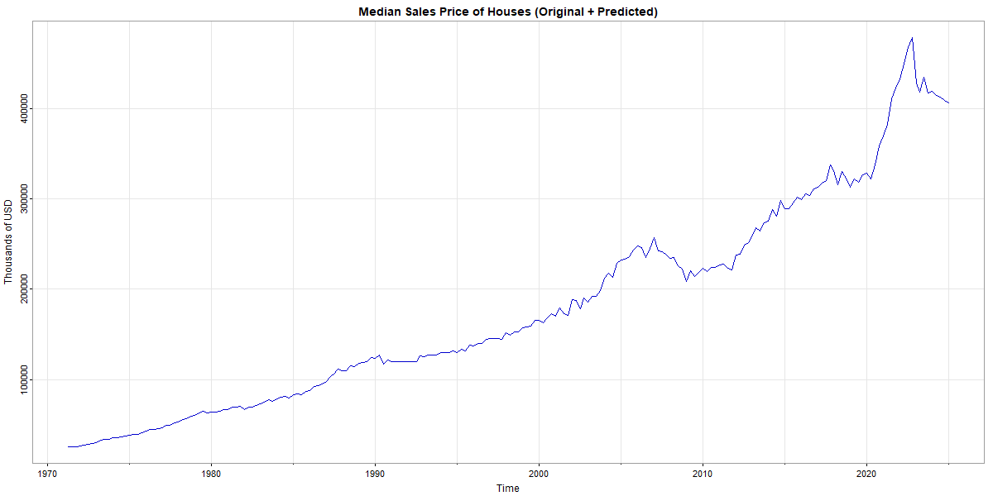
Forecasting
Forecasted Values:
2024 Qtr1: 419656.1
2024 Qtr2: 415300.8
2024 Qtr3: 412832.8
2024 Qtr4: 409781.8
2025 Qtr1: 406890.7

Slide 19
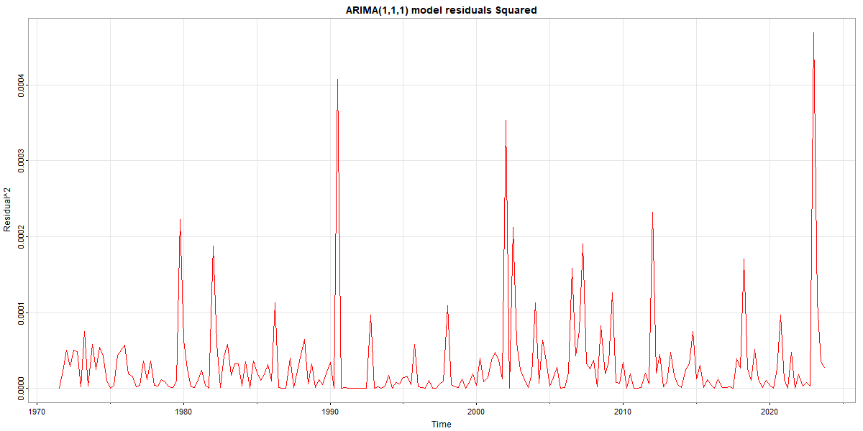
Analysis C
The plot of squared residuals from the ARIMA fit shows the residuals have conditional heteroscedasticity.
An ARCH/GARCH model should work well to model this.
We will fit three ARCH models: GARCH, IGARCH & APARCH

Slide 20
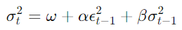
Generalized Autoregressive Conditional Heteroskedasticity (GARCH)
GARCH models assume stationarity. Use the log-differenced series for GARCH model which is stationary.
There is a need to evaluate the mean model ARMA Order and GARCH order simultaneously to fit an ARMA-GARCH model.
The mean model uses ARMA that generates the forecast for the mean of the time series, while the GARCH model generates the forecast for the variance.
The mean model will use an ARMA(1,1) and then we use different GARCH model orders.
GARCH(1,1):

Slide 21
ARMA-GARCH Model Selection
 | Akaike | Bayes | Shibata | Hannan-Quinn
sGARCH(1,0) + ARFIMA(1,0,1) | 20.553 | 20.633 | 20.552 | 20.586
sGARCH(0,1) + ARFIMA(1,0,1) | 10.578 | 10.658 | 10.577 | 10.611
sGARCH(1,1) + ARFIMA(1,0,1) | 8.4298 | 8.5257 | 8.4282 | 8.4686
sGARCH(2,1) + ARFIMA(1,0,1) | 8.406 | 8.5179 | 8.4038 | 8.4512

Slide 22
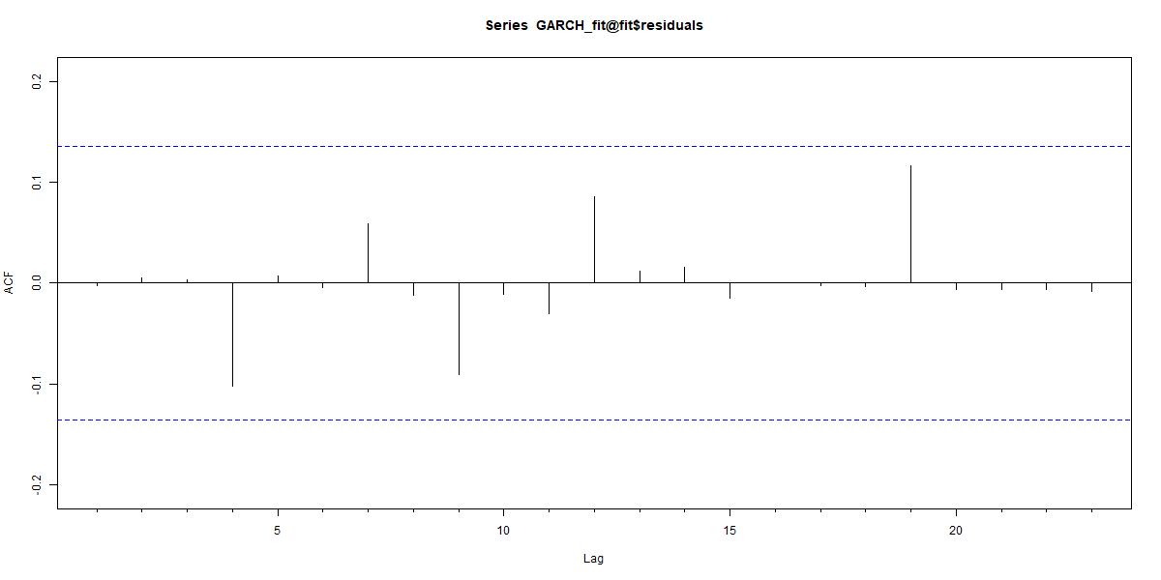
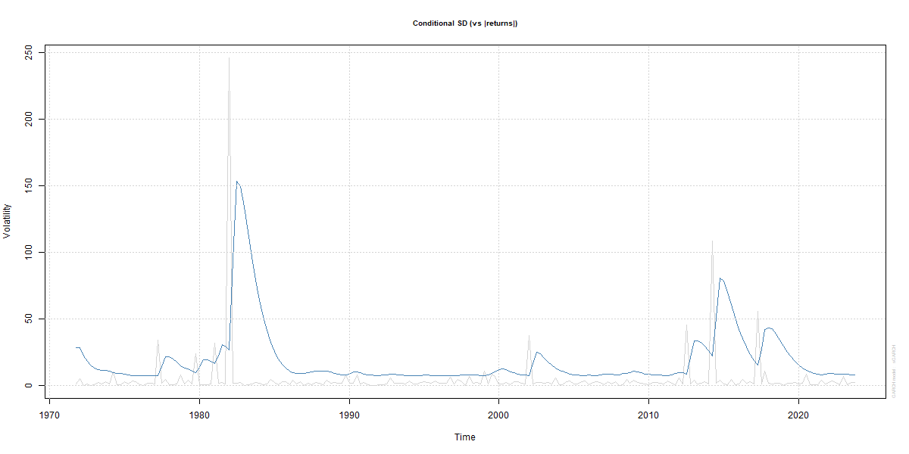

GARCH Model Fit
sGARCH(2,1) + ARFIMA(1,0,1) model fit for the return

Slide 23
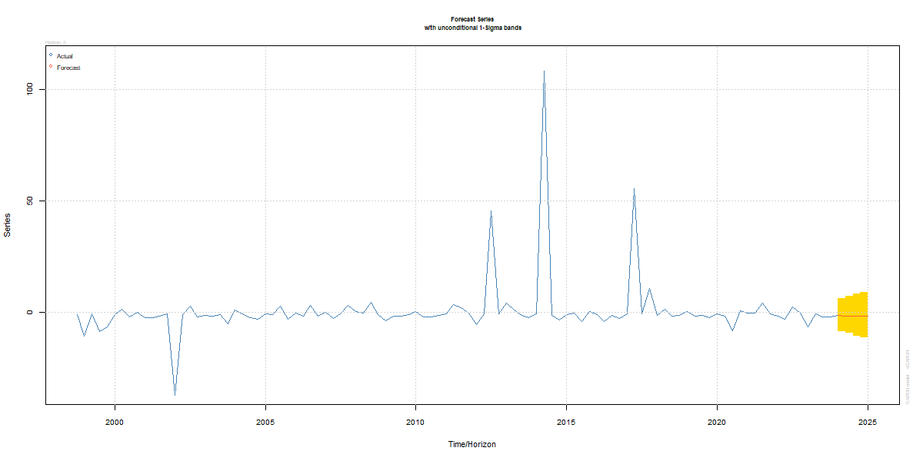
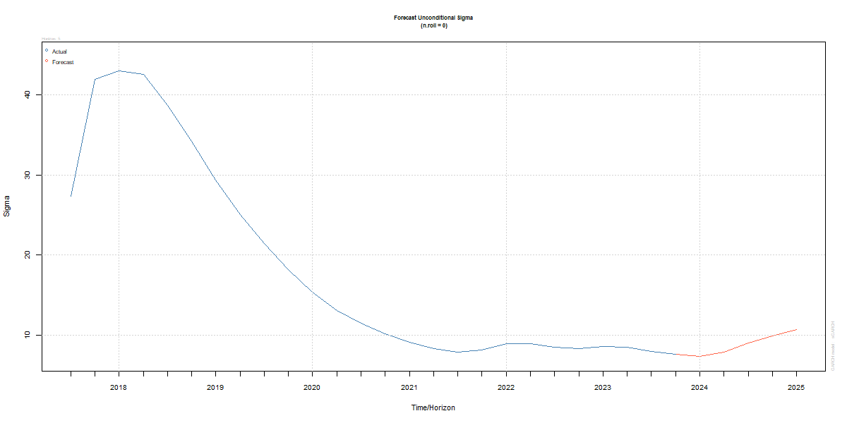
GARCH Forecast
sGARCH(2,1) + ARFIMA(1,0,1) model forecast for the return

Slide 24
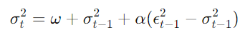
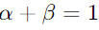
Motivation behind an IGARCH Model
A variant of the standard GARCH designed to address scenarios where the persistence of volatility shocks is extremely high.
Assumes that shocks to the variance are so persistent that they have a permanent effect on the variance level.
The Integrated GARCH (IGARCH) model implies that any shocks to volatility will affect all future volatility forecasts, not just the immediate future (“long-term memory”).
IGARCH(1,1):

Slide 25
ARMA-IGRCH Model Selection
 | Akaike | Bayes | Shibata | Hannan-Quinn
iGARCH(1,1) + ARFIMA(1,0,1) | 8.8578 | 8.9217 | 8.8571 | 8.8836
iGARCH(0,1) + ARFIMA(1,0,1) | 8.8673 | 8.9473 | 8.8662 | 8.8997
iGARCH(2,1) + ARFIMA(1,0,1) | 8.8769 | 8.9729 | 8.8753 | 8.9157
iGARCH(1,2) + ARFIMA(1,0,1) | 8.8767 | 8.9727 | 8.8752 | 8.9155

Slide 26
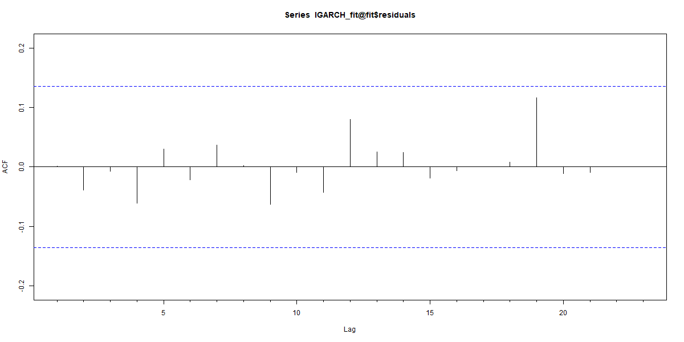
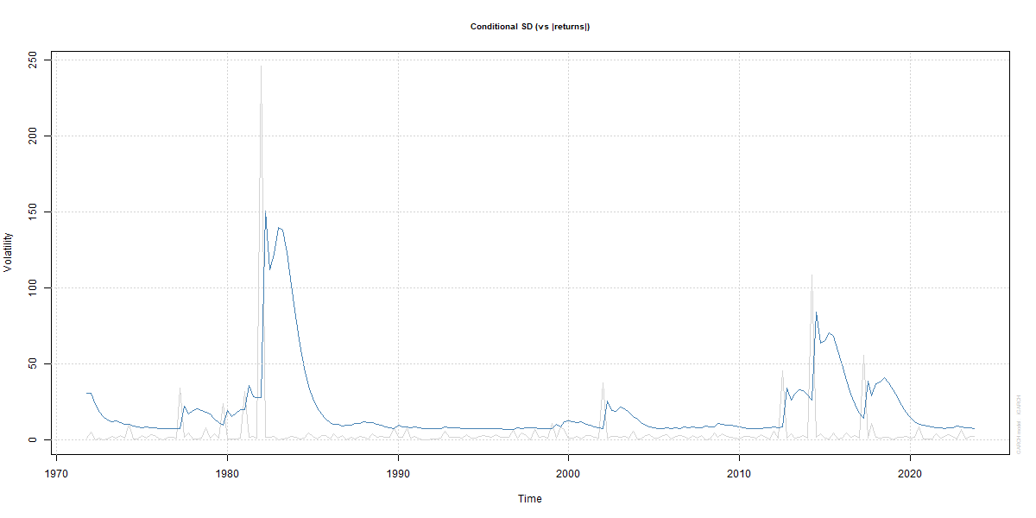

IGARCH Model Fit
iGARCH(1,1) + ARFIMA(1,0,1) model fit for the return

Slide 27

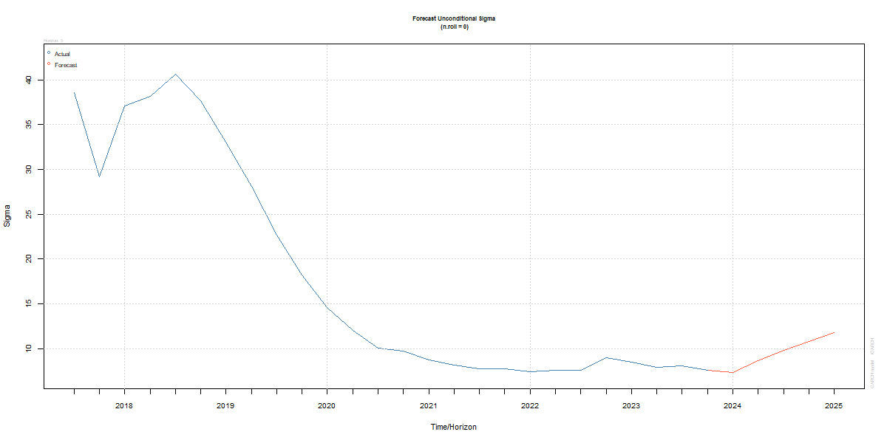
IGARCH Forecast
iGARCH(1,1) + ARFIMA(1,0,1) model forecast for the return

Slide 28
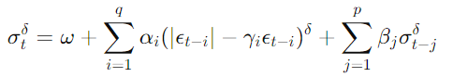
Motivation behind an APARCH Model
An extension of the GARCH that introduces more flexibility in terms of handling asymmetries and differentiating the impact of large versus small, and positive versus negative returns.
In financial markets negative shocks tend to increase volatility more than positive shocks of the same magnitude (“Leverage Effect“).
The power term 𝛿 in Asymmetric Power ARCH (APARCH) models provides flexibility in capturing the thickness of tails and the peak of the volatility distribution.

Slide 29
ARMA-APRCH Model Selection
 | Akaike | Bayes | Shibata | Hannan-Quinn
apARCH(0,1) + ARFIMA(1,0,1) | 8.8037 | 8.8996 | 8.8021 | 8.8425
apARCH(1,0) + ARFIMA(1,0,1) | 19.47 | 19.582 | 19.468 | 19.515
apARCH(2,2) + ARFIMA(1,0,1) | 12.836 | 12.98 | 12.833 | 12.894
apARCH(2,0) + ARFIMA(1,0,1) | 7.6595 | 7.8354 | 7.6543 | 7.7306

Slide 30

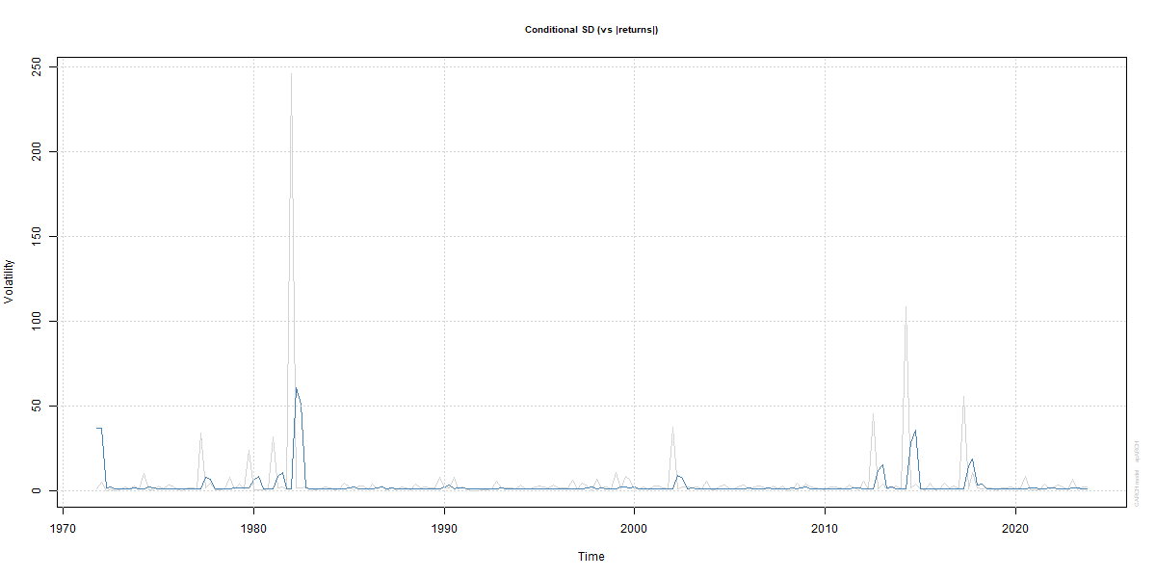

APARCH Model Fit
apARCH(2,0) + ARFIMA(1,0,1) model fit for the return

Slide 31
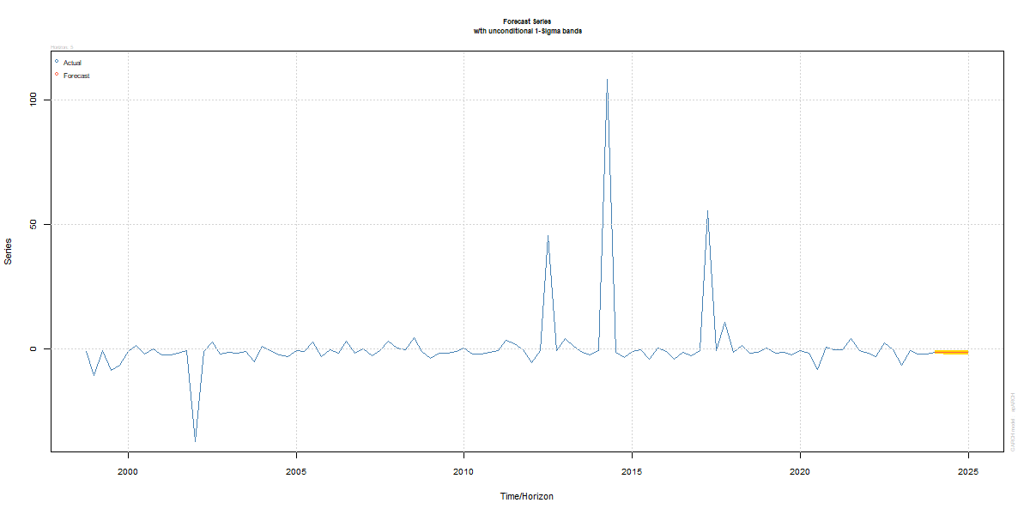
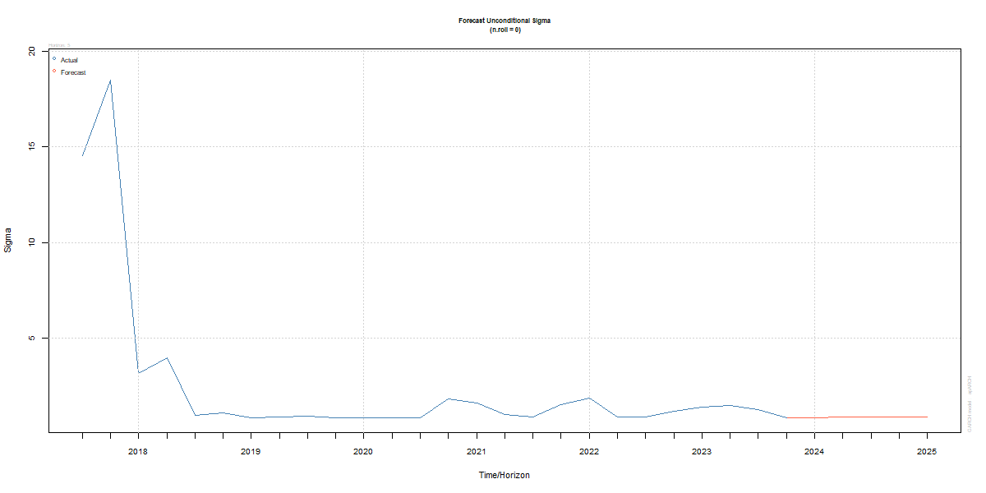
APARCH Forecast
apARCH(2,0) + ARFIMA(1,0,1) model forecast for the return

Slide 32
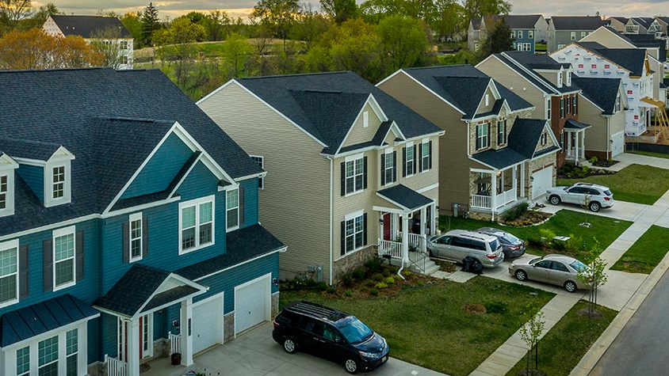
Comparison of Results
GARCH vs IGARCH vs APARCH

Slide 33
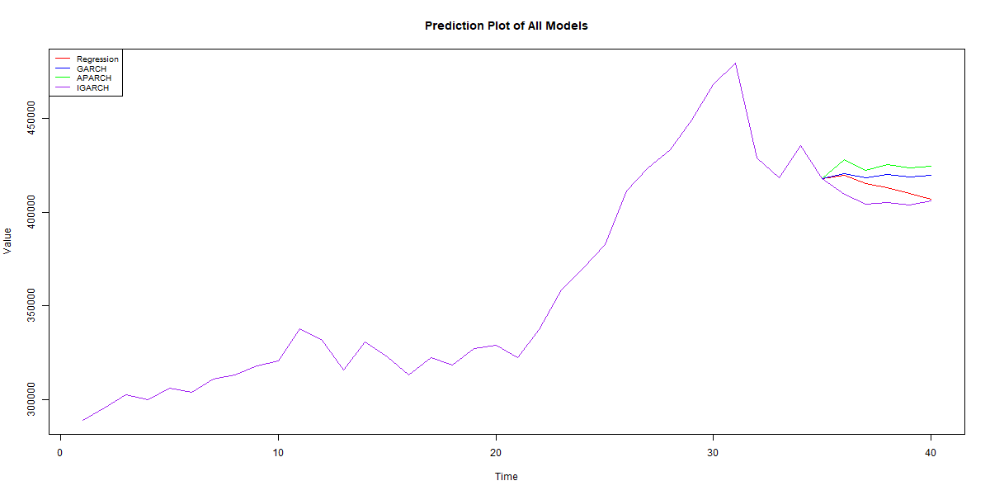
Model Forecast Comparison
GARCH, APARCH & IGARCH models predict returns differently.
This results in different values of the predicted values.

Slide 34
Model Forecast Comparison
GARCH
IGARCH
APARCH
GARCH reacts sharply to new information (higher alpha) but suffers from high persistence (too high beta).
IGARCH also reacts sharply to new information but consistently overestimates volatility (high persistence).
APARCH fails to respond to new information quickly and consistently underestimates peaks.

Slide 35
Conclusion
MSACSR (Median Sales Price of Houses Sold) and MORTGAGE30US (30 Year Fixed Rate Mortgage Average) are significant predictors of housing prices.
ARIMA (1,1,1) shows the best performance among all models tested with autocorrelated errors.
All three ARCH models fail to capture volatility patterns with a high degree of satisfaction.
APARCH model does not seem to model negative volatility much differently from positive volatility. This may be due to very limited negative shocks experienced by the housing market, historically.
The forecasted values for ARIMA and ARCH models are fairly similar.

Slide 36

Questions?

